Slide 1

25
50
22
09
-3
47

Slide 2
25
50
16
81
-9
41

Slide 3
25
50
27
04
+2
52

Slide 4

56
3136

Slide 5
49
2401

Slide 6
43
1849

Slide 7
59
3481

Slide 8
54
2916

Slide 9
98
100
96
04
-2
98

Slide 10
104
100
108
16
+4
104

Slide 11
92
8464

Slide 12
107
11449

Slide 13
95
9025

Slide 14


Slide 15
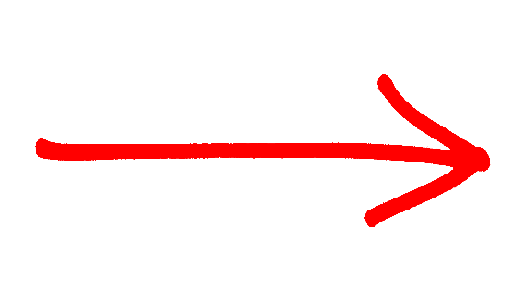
9
2
90
25
9
10
X
=

Slide 16
6
2
42
25
6
7
X
=

Slide 17
3
2
12
25

Slide 18
7
2
56
25

Slide 19

2
11
132
25

Slide 20
What if you had other numbers?

Slide 21
67²
67 X 67
=
?
123² = 123 X 123

Slide 22
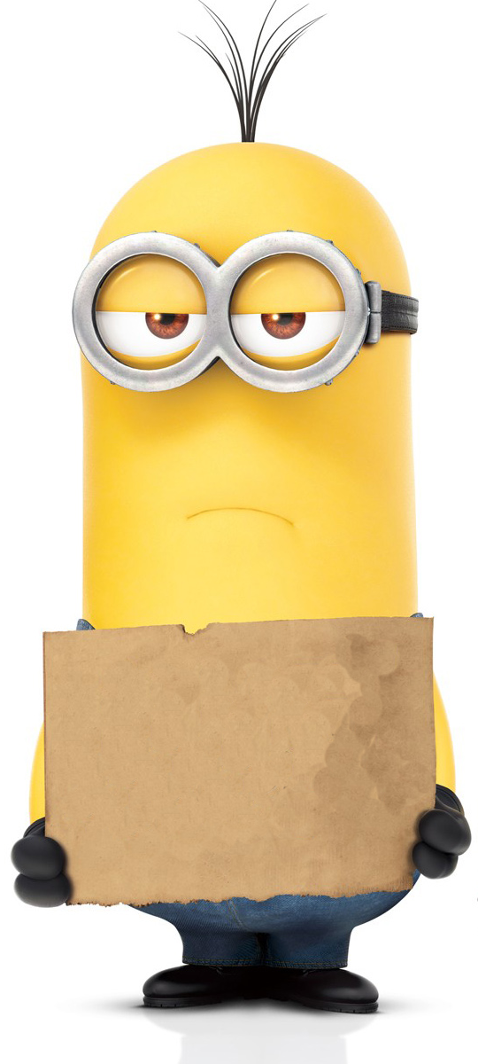
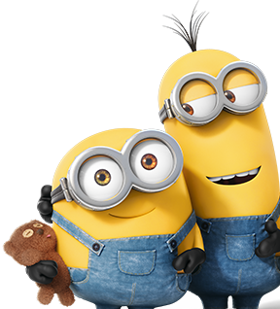
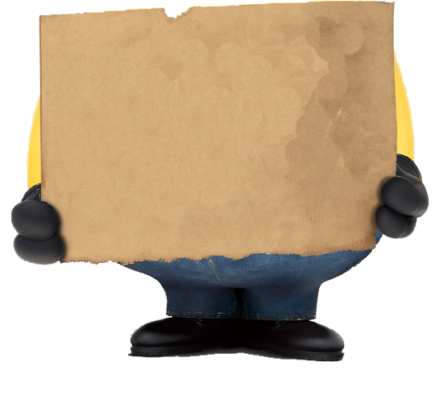

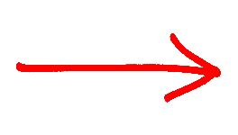
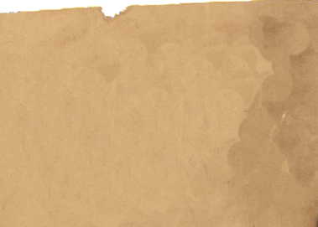
67²
b²
a²
49
36
=
+
(a + b)²
( + )²
6
7
84
X
X 42
2
X6X7
AB
44
8
9

Slide 23
36²
b²
a²
36
9
=
+
( + )²
3
6
36
X
X18
2
X3X6
AB
12
9
6

Slide 24
77²
b²
a²
49
49
=
+
( + )²
7
7
98
X
2
X49
X7X7
AB
59
2
9

Slide 25
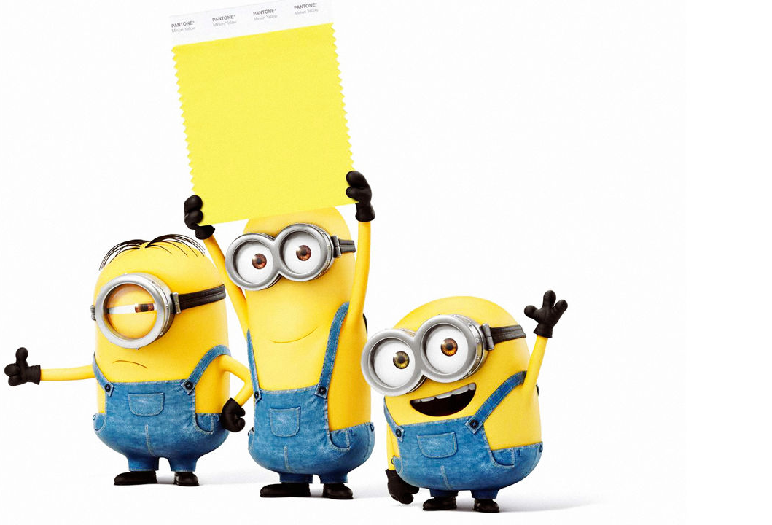
4096
64²

Slide 26
7921
89²

Slide 27
123²
144
09
=
+
( + )²
12
3
72
151
2
9

Slide 28
48841
221²

Slide 29
222784
472²

Slide 30
=
72²
7
2

Slide 31
98
2
Cuz ‘b’ should always be a single digit
=
Why not 9 and 82?
982²

Slide 32
=
4
1094²
109

